Slide 1
FHIR ValueSet Tutorial
Grahame Grieve
11 July 2014
Regenstrief

Slide 2
Value Set Resource
Value set resource initially defined to support the Profile resource
“this set of codes here”

Slide 3
Value Set Summary
Metadata
0..1 Inlined code system definition
0..* Composition Statements
Include other value sets
In/Exclude some or all codes from a codesystem
In/Exclude codes based on codesystem properties
0..1 Expansion (=actual content at a given time)

Slide 4
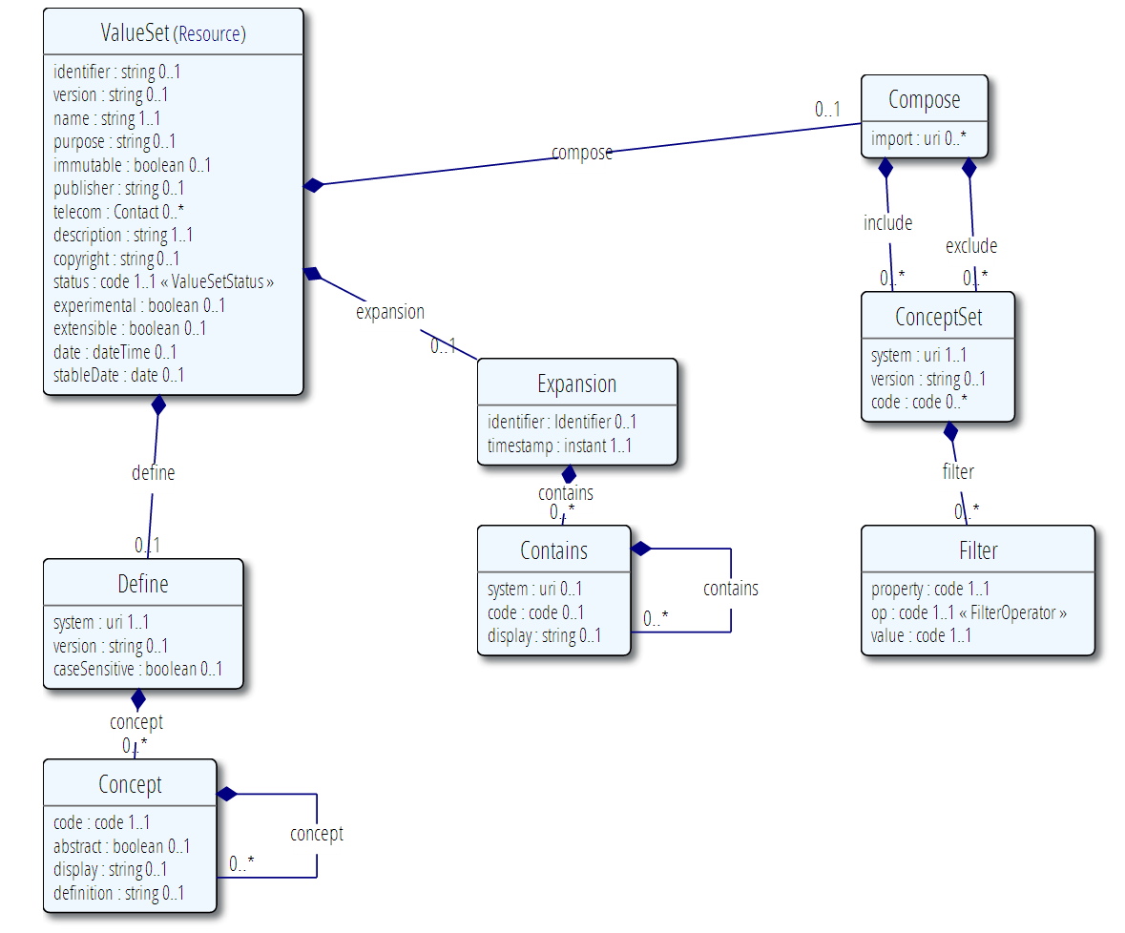

Slide 5
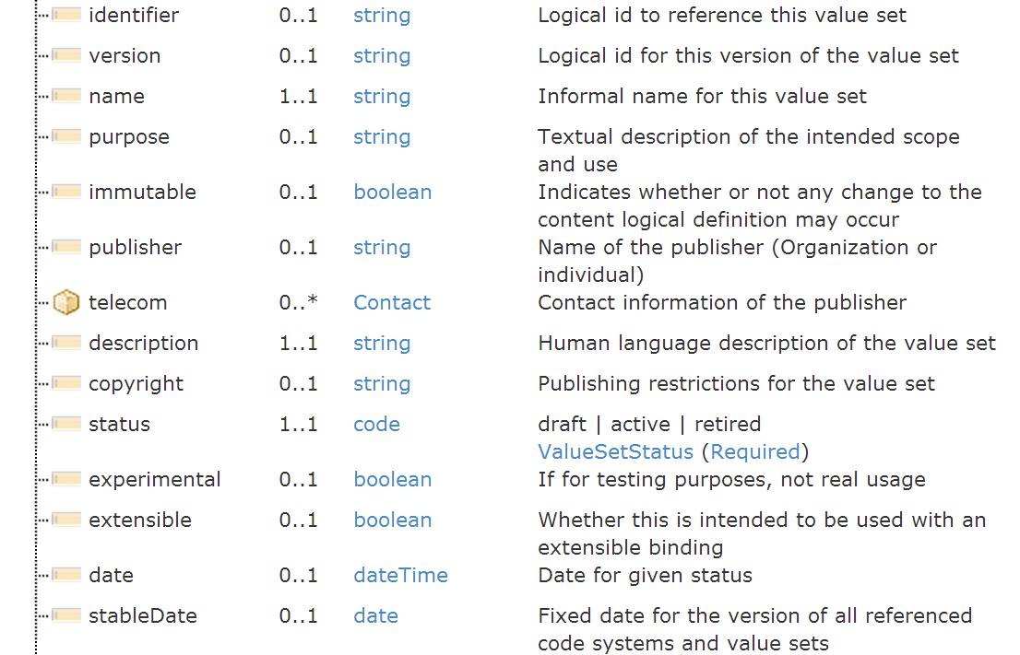
Metadata

Slide 6
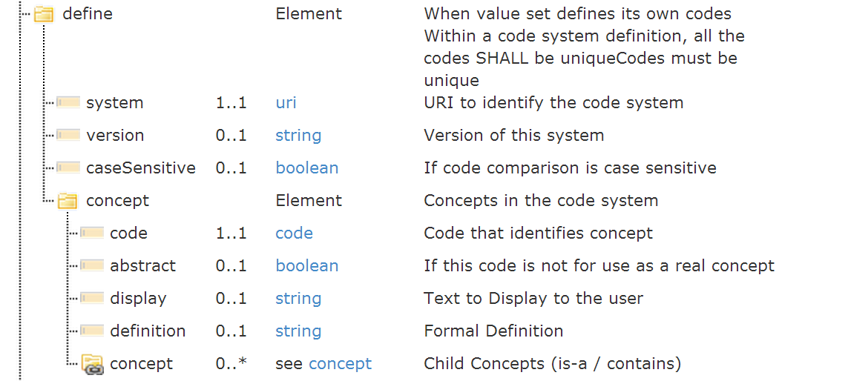
Inline Code System

Slide 7
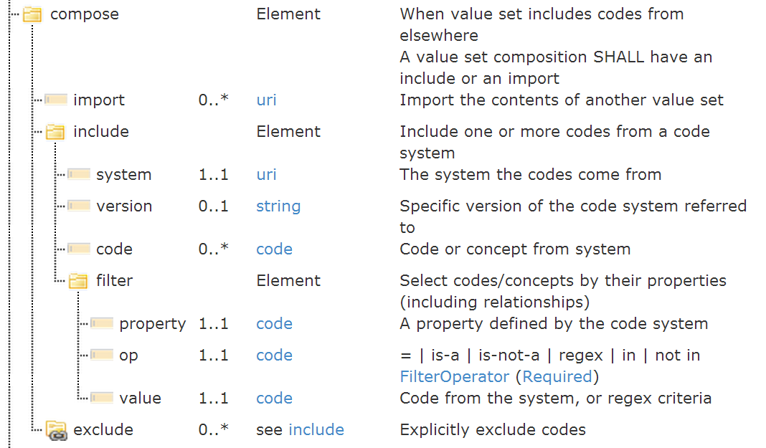
Compose from Elsewhere

Slide 8
Example Value sets
Examples from specification and HSPC set

Slide 9
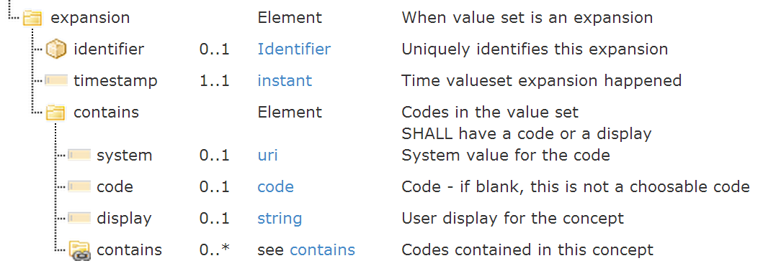
What’s actually in the value set?

Slide 10
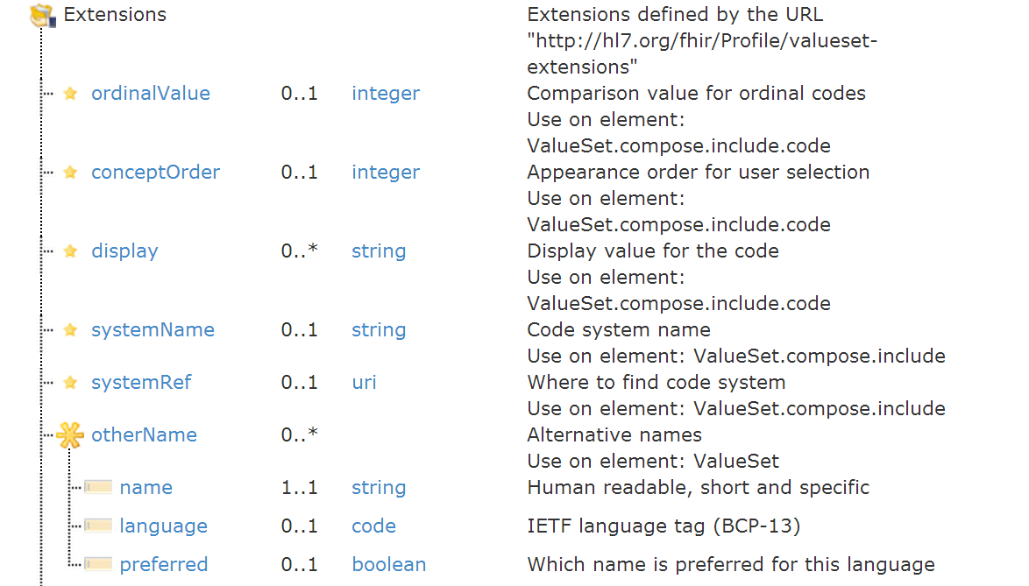
Value set Extensions #1

Slide 11
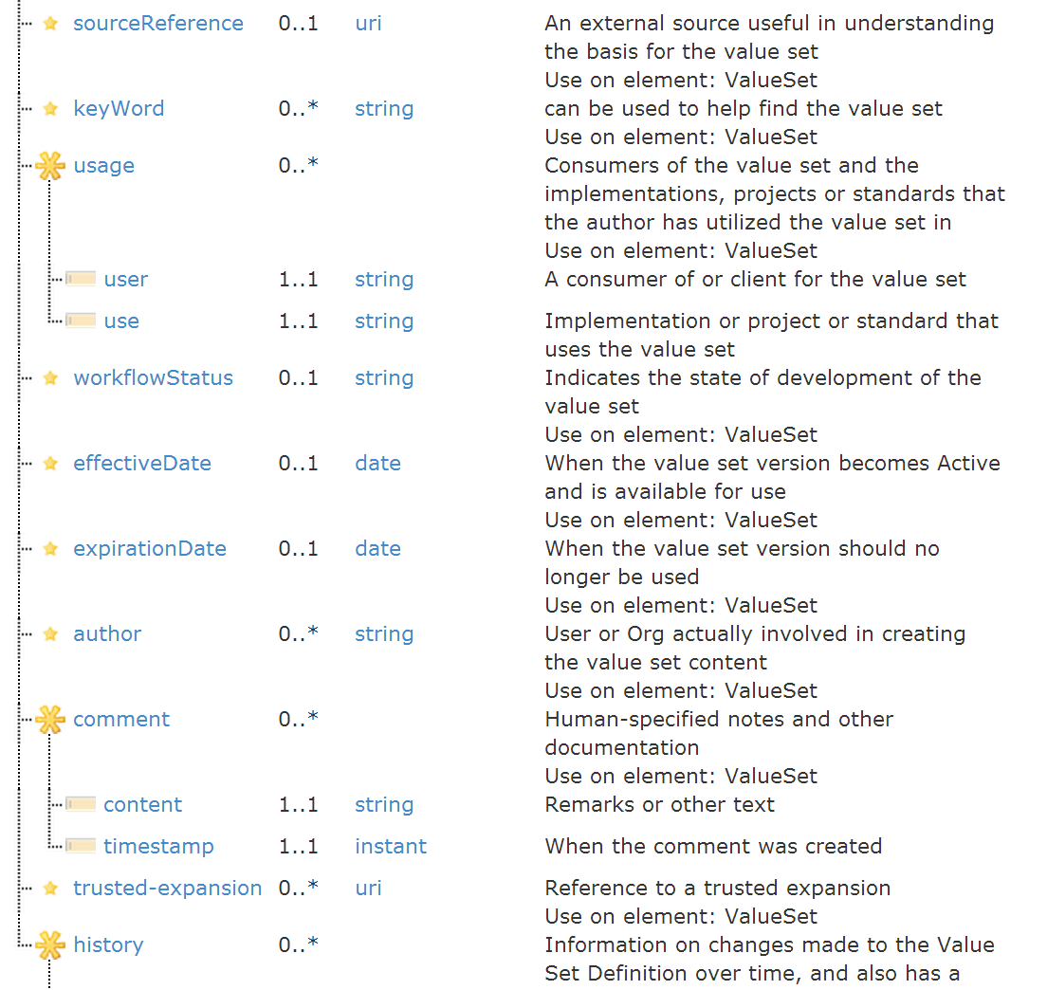
ValueSet Extensions #2

Slide 12
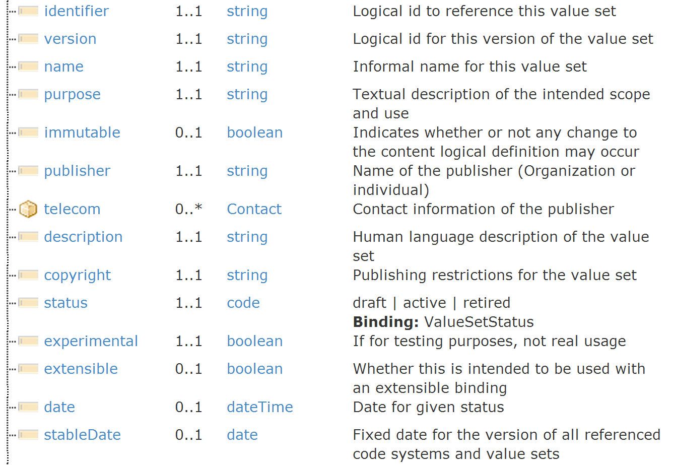
HL7 Registry Profile

Slide 13
Operations
Expand a value set
Text filter (+ mapping filter)
Is a coding in a value set?
Does a codeableConcept contain a coding in the valueset?
Subsumption testing
Is this code in the value set of descendents of that code?

Slide 14
Inducting a Code system
What URI will be used to identify it?
What are valid codes? (syntax, expression?)
What are valid display names?
What properties can be used to define extensional value sets?

Slide 15
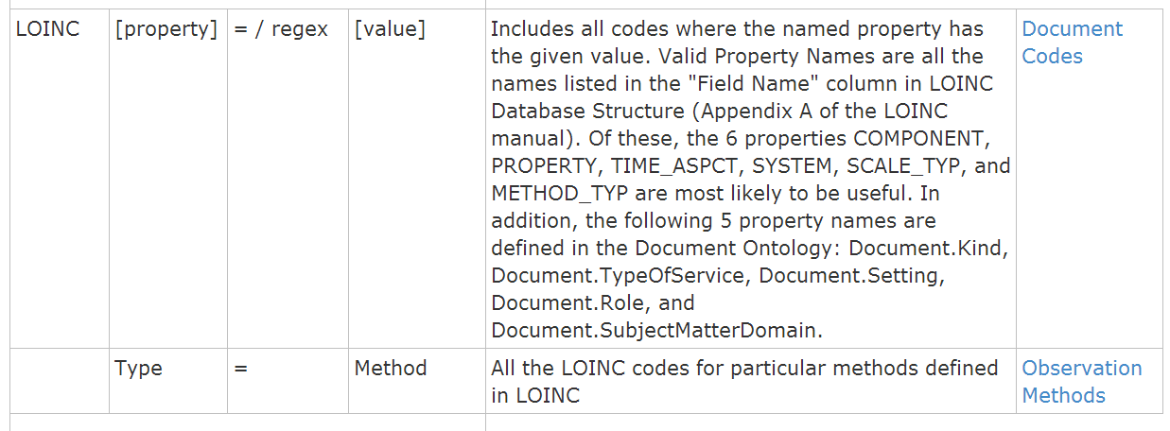
LOINC in FHIR
URI: http://loinc.org
Valid codes: LOINC identifiers e.g. 1234-5
Display Name: LONG_COMMON_NAME
Properties:

Slide 16
Concept Map Summary
Map from one set of concepts to another
Concepts = elements in a model
Concepts = codes in a value set
Maps from source to target
Mapping is uni-directional
equal | equivalent | wider | subsumes | narrower | specialises | inexact | unmatched | disjoint
Can be multi-part

Slide 17
Concept Map Example
Source (Fhir Address Use) | Equivalence | Target (v3 address use) | Comments
home | equivalent | H
work | equivalent | WP
temp | equivalent | TMP
old | disjoint | BAD | In the V3 AD, old is handled by the usablePeriod element, but you have to provide a time, there's no simple equivalent of flagging an address as old

Slide 18
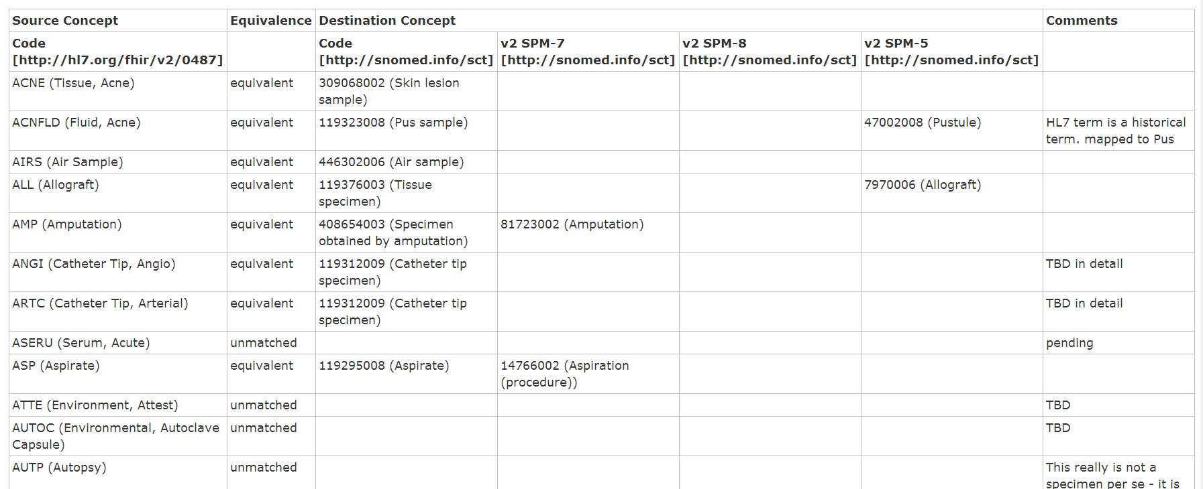
Concept Map Example
http://hl7.org/fhir/conceptmap-example-specimen-type.html

Slide 19
Concept Map Operations
Translate code
In: code / system [/version] + value set (optional)
Out: code / system + errors, hints, warnings
Are codes related?
In: (code / system [/version]) 2 + value set (opt)
Out: errors, hints, warnings

Slide 20
FHIR Terminology Server
Authoring:
ValueSet / ConceptMap
Standard FHIR repository
Services:
Expand a value set - for UI look up / code gen
Is a coding valid – for validation
Subsumption / meaning testing
Translation

Slide 21
Leveraging Value Sets
FHIR Project provides (or will do):
Renderer – shows a value set/conceptmap to a human
Value Set Expansion (code & server)
Including with text filtering for UI support
Conformance Testing (code & server)
Full blown terminology server (open source)
Full featured repository (Private or public)
All with full mapping support

Slide 22
Functions for Value Sets
Support the conformance process:
May be design time functionality only
Provide Run time services (optional):
Populate UI from value set expansion
Test value set membership
Use from operational resources:
Questionnaire, Device, Coding data type
Value set is part of medical record
Does not require services, but can leverage them

Slide 23
LOINC Value set Issues
No formal support for type=method
Granularity Problem

